Slide 1
Genetic Correlates of ADHD
Alex Loftus

Slide 2
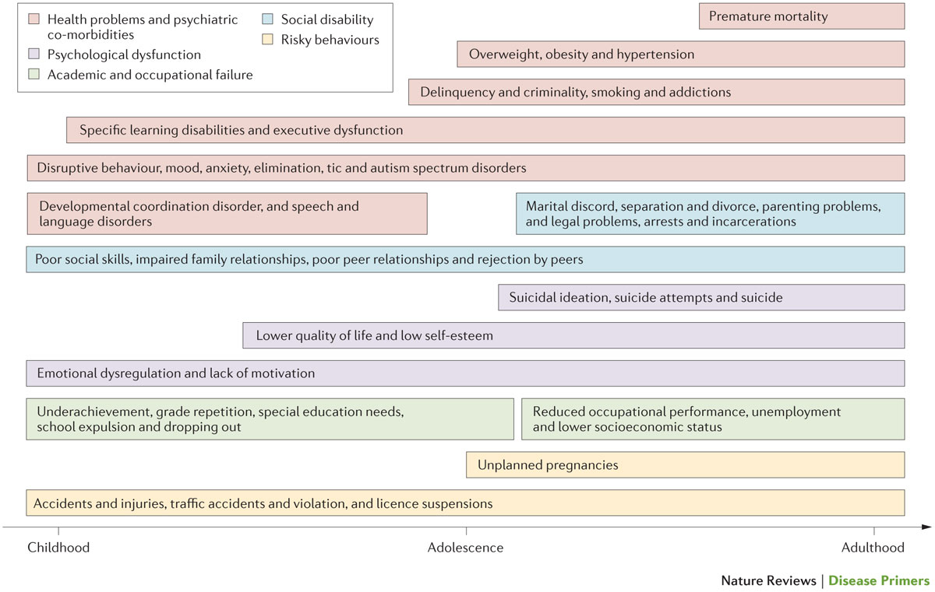
Background
5% of children, 2.5% of adults
Many harmful outcomes¹
Notes:
Neurodevelopmental disorder with a high population prevalence
Inattention or hyperactivity – attentional signal-to-noise ratio is lower
Association with a host of negative life outcomes (lower education and underachievement, impaired relationships, and health issues, among other negative effects)
---------------------
Associated with
lower education
Other neurodevelopmental disorders
Delinquincy
Impaired relationships
Underachievement / dropping out
Diagnosed with a clinical interview along with rating scales

Slide 3
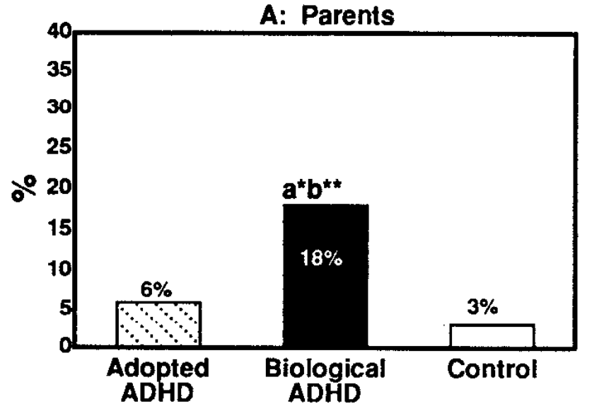
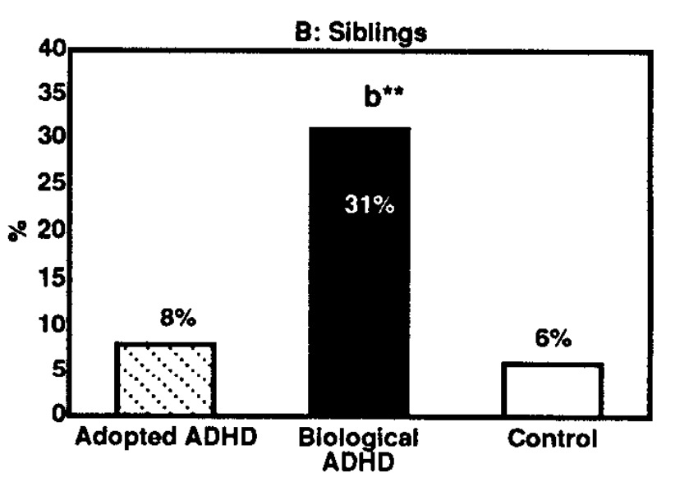
Heritability
70-80% heritability from twin studies⁷
Heritability disappears for adopted families^{5,6}
Massively polygenic²
Notes:
All throughout the 70s-90s, twin studies were finding high heritability
Adoption studies also show high heritability (figure)
--------------------------------------------------
Parents/siblings of patients with ADHD have between fivefold and tenfold increase in prevalence compared to general population
Twin studies were finding high heritability all through the mid 80s and 90s

Slide 4
So, clear genetic component

Slide 5
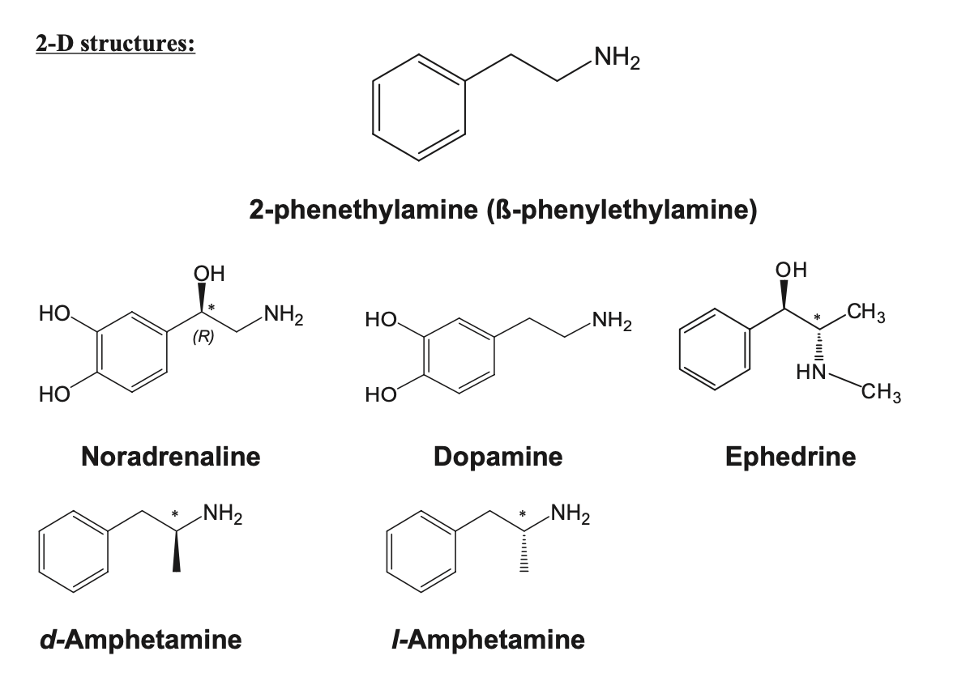
Amphetamines
Early ADHD studies looked for associations in dopamine-related genes
Notes:
Which genes?
Amphetamines have been used to treat ADHD since the 60s, after being used as wakefulness drugs in WW2
Amphetamines affect the catecholamine system, notably dopamine, by inhibiting dopamine reuptake

Slide 6
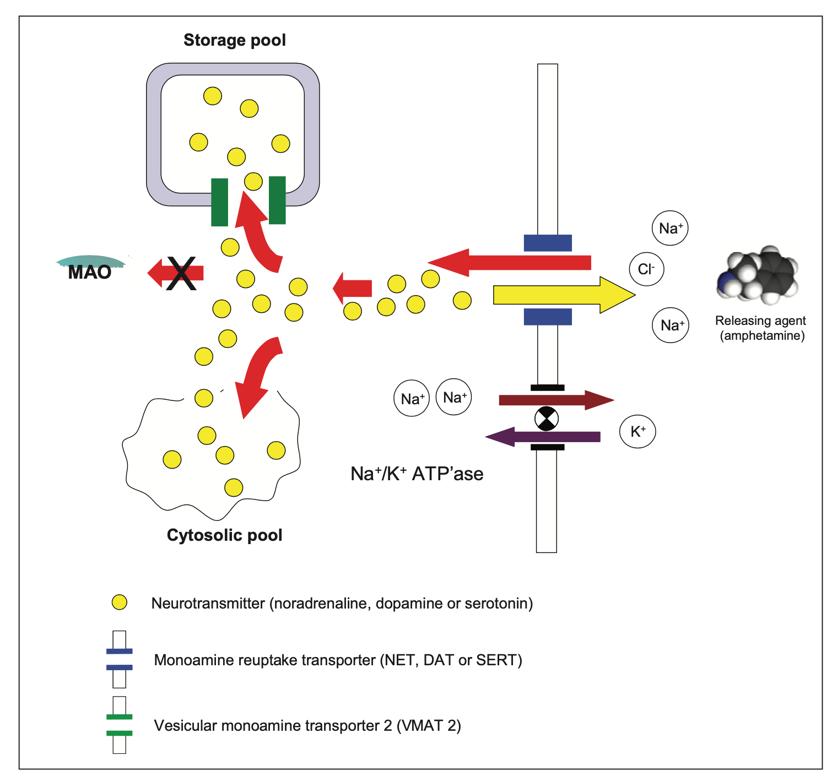
Early candidate genes
SLC6A3: dopamine transporter⁴
DRD*: dopamine receptors
SL6A4: serotonin transporter
HTR1B: serotonin receptor
Notes:
Because amphetamines inhibit dopamine reuptake, early candidate genes were generally involved in the dopamine system
Dopamine transporters, receptors,
Genes relevant to other catecholamines like serotonine also candidates

Slide 7
Early association studies explored these gene candidates

Slide 8
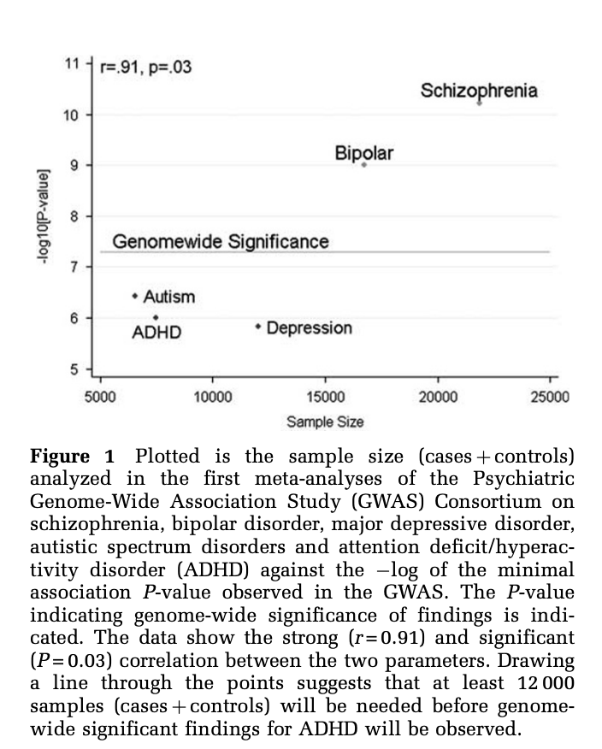
But, sample size too low!
Notes:
GWAS: genome wide association study
Need extremely large number of samples for significance in GWAS studies
Early ADHD GWAS studies were conducted, but had sample sizes of around 7000
Twin and adoption studies show large genetic component, so motivation for higher sample size

Slide 9
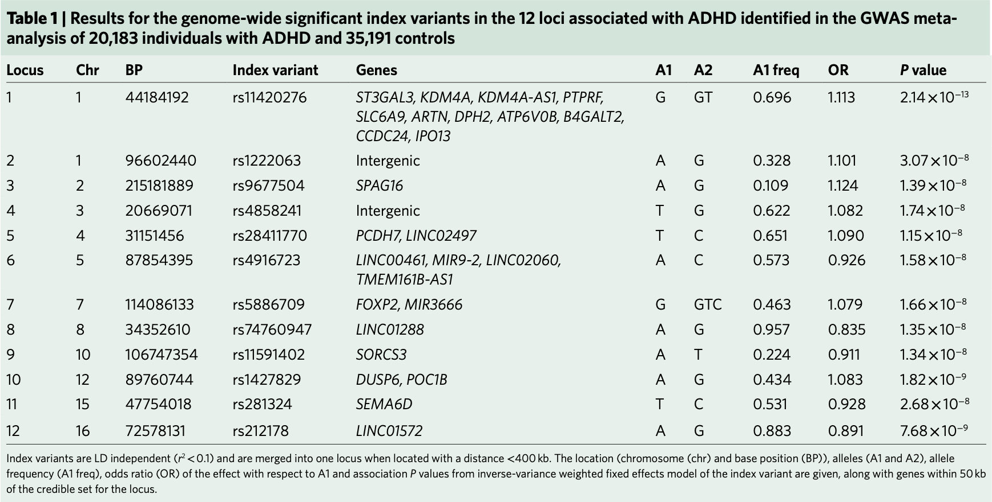
Demontis et al, 2018
GWAS with 20,183 clinically diagnosed ADHD individuals, 35,191 controls
International collaboration, 100+ authors
First study to find loci above the threshold of statistical significance
Notes:
Due in large part to the motivation provided by the high genetic inheritance in these twin and adoption studies, an international collaboration was formed in 2016 to get a large-enough sample size to obtain a GWAS with statistical significance
The result had a sample size of 20,183 ADHD individuals, with 35,191 controls
This was the first study to find loci above the threshold of statistical significance
Almost none of the candidate genes were significant!
------------------------
FOXP2 (chrom7): encodes transcription factor important in synapse formation and development of speech/learning
Intronic association in chromosome 10 (SORCS3), encodes brain-expressed transmembrane receptor important for neuronal development and plasticity
Chromosome 12: DUSP6, encodes a phosphatase which plays a role in regulating neurotransmitter homeostasis by affecting DA levels
SEMA6D: chrom15, active during embryonic development
Chromosome 1 locus is a 250kb region, lots of genes, index variant on ST3GAL3

Slide 10
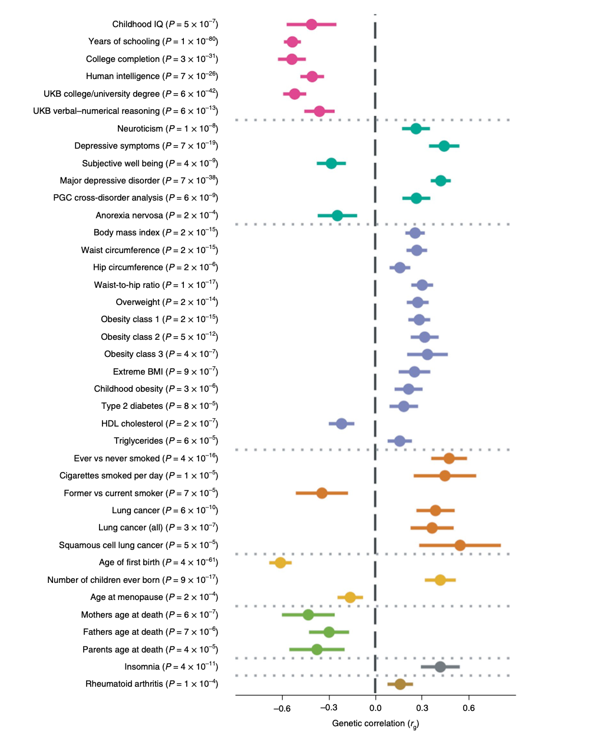
Co-aggregation with depression, conduct problems, schizophrenia, bipolar disorder, autism spectrum disorders¹
Notes:
57% increased rates among parents/siblings of ADHD children

Slide 11
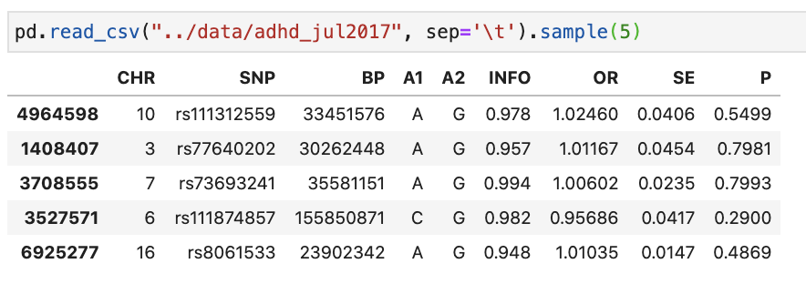
Notes:
8,047,420 SNPs
Pvalues, mutual info, standard error, and odds ratio precalculated

Slide 12
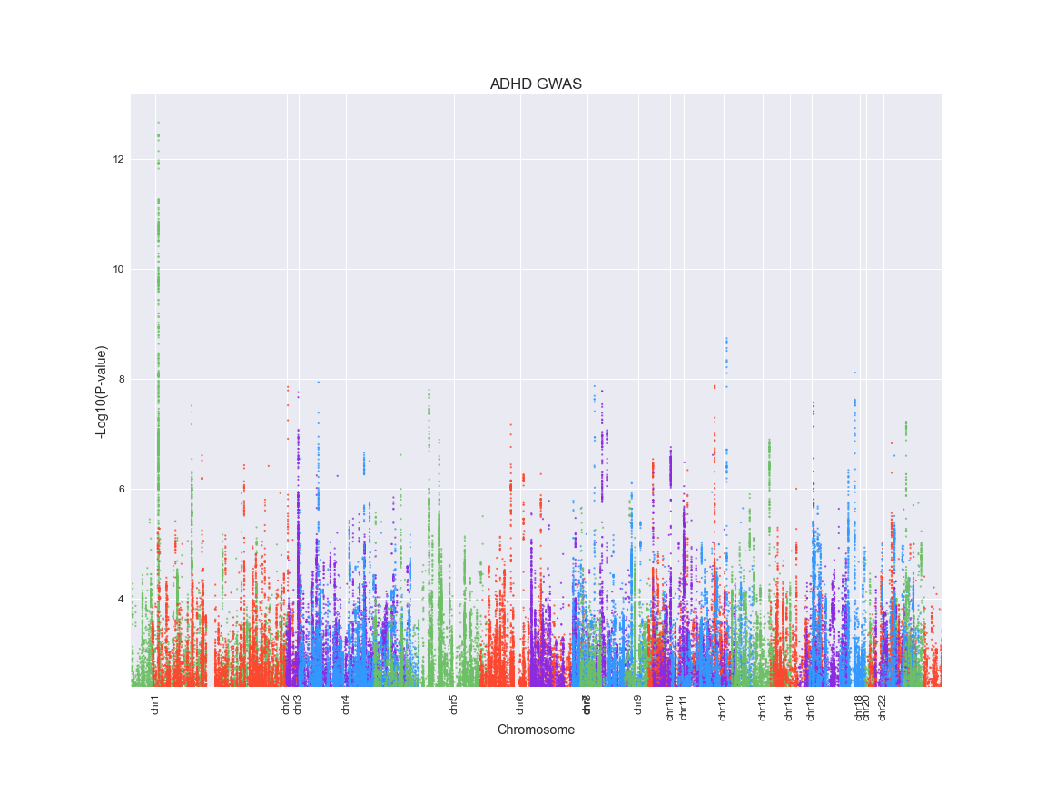
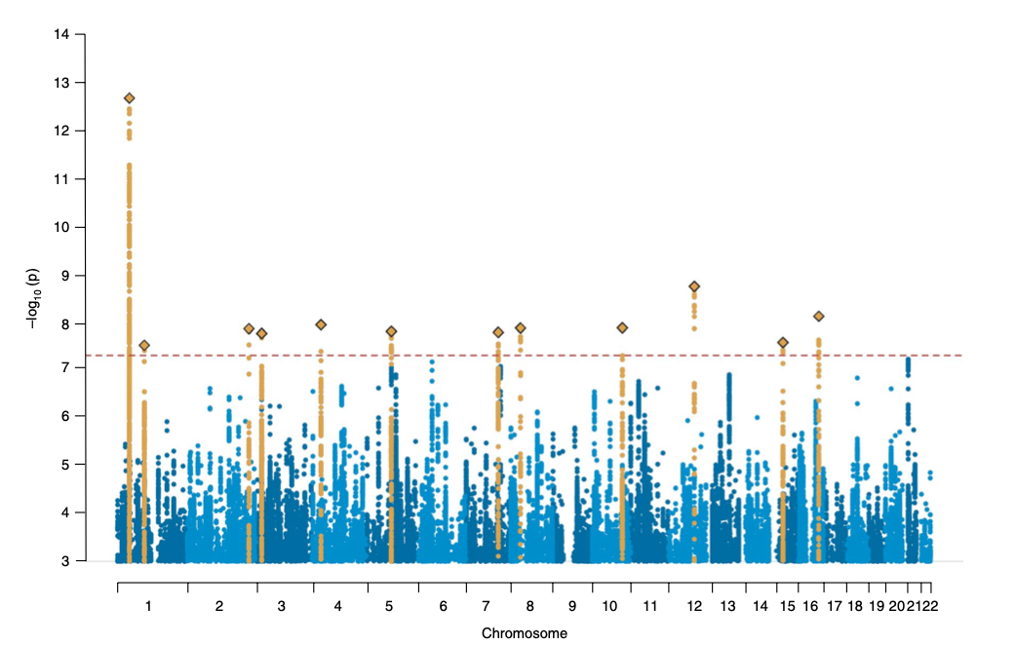
Notes:
Started with plotting the manhattan plot, to make sure the data was the same
Statistically significance at higher than 7.2 in –log_10(p)

Slide 13
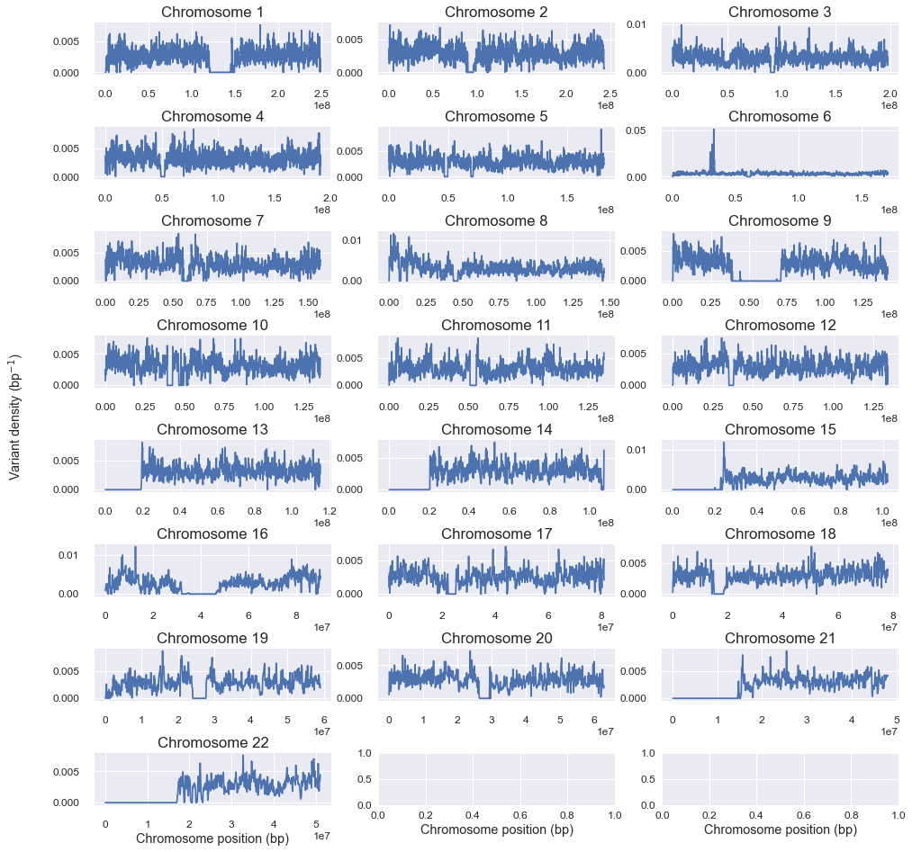
Notes:
Then, for each chromosome, I plotted the SNP density as a function of BP location
In windows of 100,000 BP, compute variant density in each window
Plot the results
Two interesting things:
1) Some chromosomes have large areas with no variant density
2) Chromosome 6 has a particular area with high variant density

Slide 14
Clustering by Position
100,000 highest p-values
Mean-shift clustering within chromosome¹⁰
Keep highest p-value within clusters
8,047,420 rows > 6000 rows
Notes:
Then, I clustered by position.
Wanted to thin the data (too much to work with)
Wanted to take only high significant SNPs in areas that corresponded to a particular gene (if there are clusters of variants in one area, they probably correspond to a particular gene)
MeanShift: centroid-based. Update candidates for centroids to be the mean of points within a given region.
Bandwidth dictates size of region to search through. I used bandwidth of 400,000.
Poor scalability (requires multiple nearest-neighbor searches during execution).

Slide 15
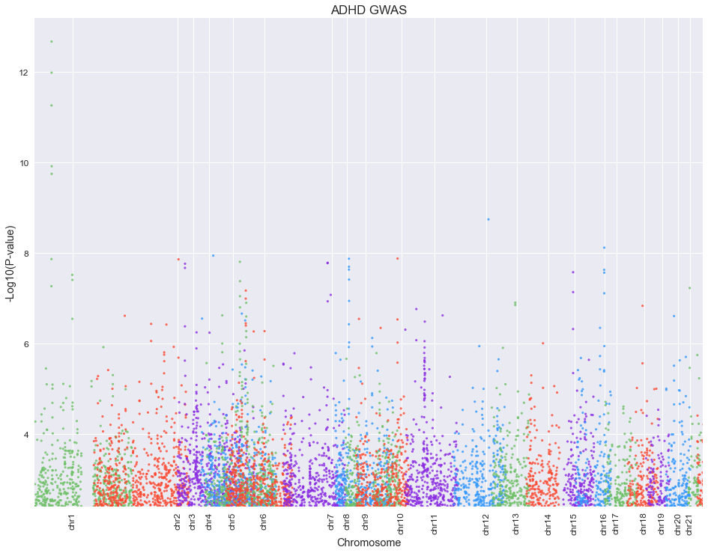
bw=40,000
Notes:
Clustering by position thinned the number of SNPs dramatically
Max p-values within each region conserved
Still keeps some SNPs within-region

Slide 16
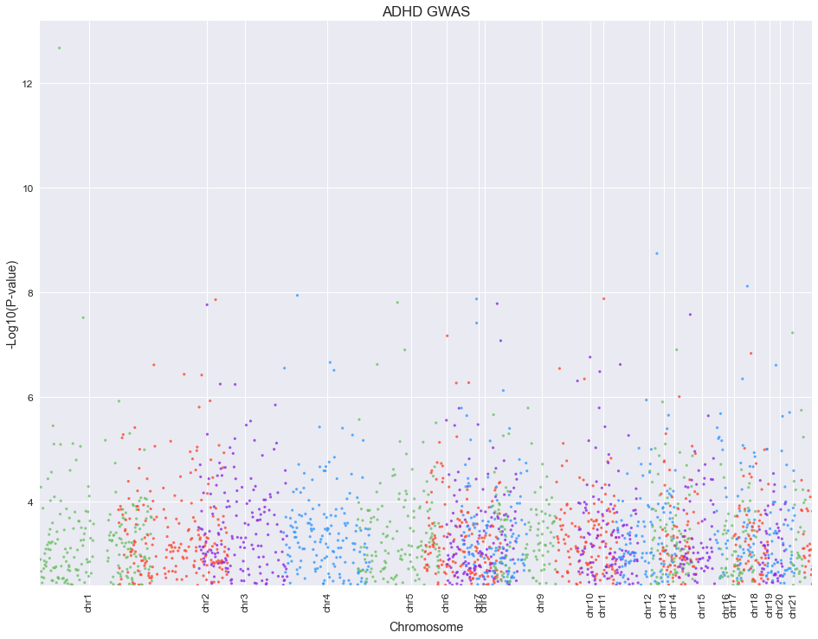
bw=400,000
Notes:
With a 400,000 bandwidth, max pvalues were still conserved within-region, but the plot was thinned much more dramatically

Slide 17
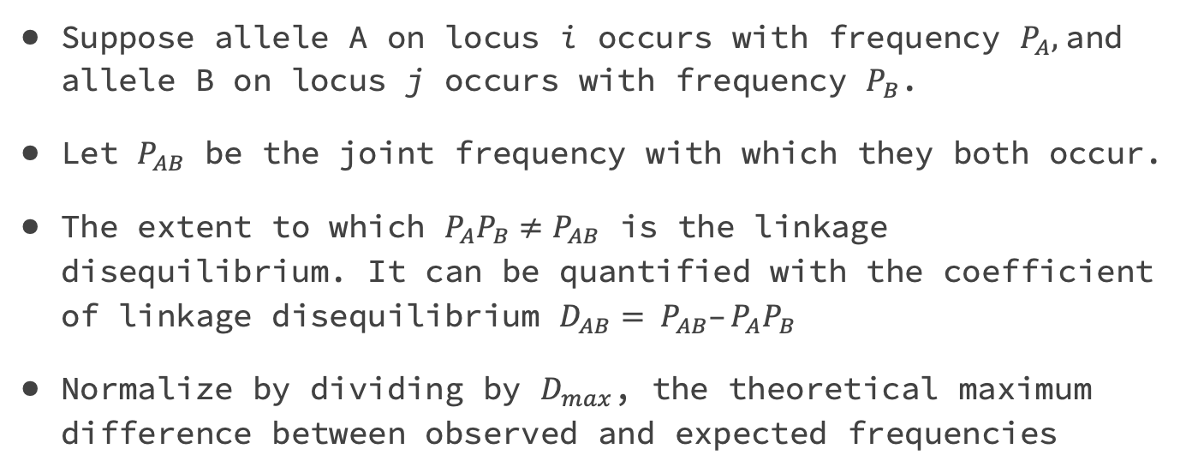
Linkage Disequilibrium⁸
Suppose allele A on locus i occurs with frequency $P_{A},$and allele B on locus j occurs with frequency $P_{B}$.
Let $P_{AB}$ be the joint frequency with which they both occur.
The extent to which $P_{A}P_{B}≠P_{AB}$ is the linkage disequilibrium. It can be quantified with the coefficient of linkage disequilibrium $D_{AB}= P_{AB}–P_{A}P_{B}$
Normalize by dividing by $D_{max}$, the theoretical maximum difference between observed and expected frequencies
Notes:
Next, I wanted to explore how this clustering changed the linkage disequilibrium
Linkage disequilibrium is essentially the extent to which allele frequency covaries

Slide 18
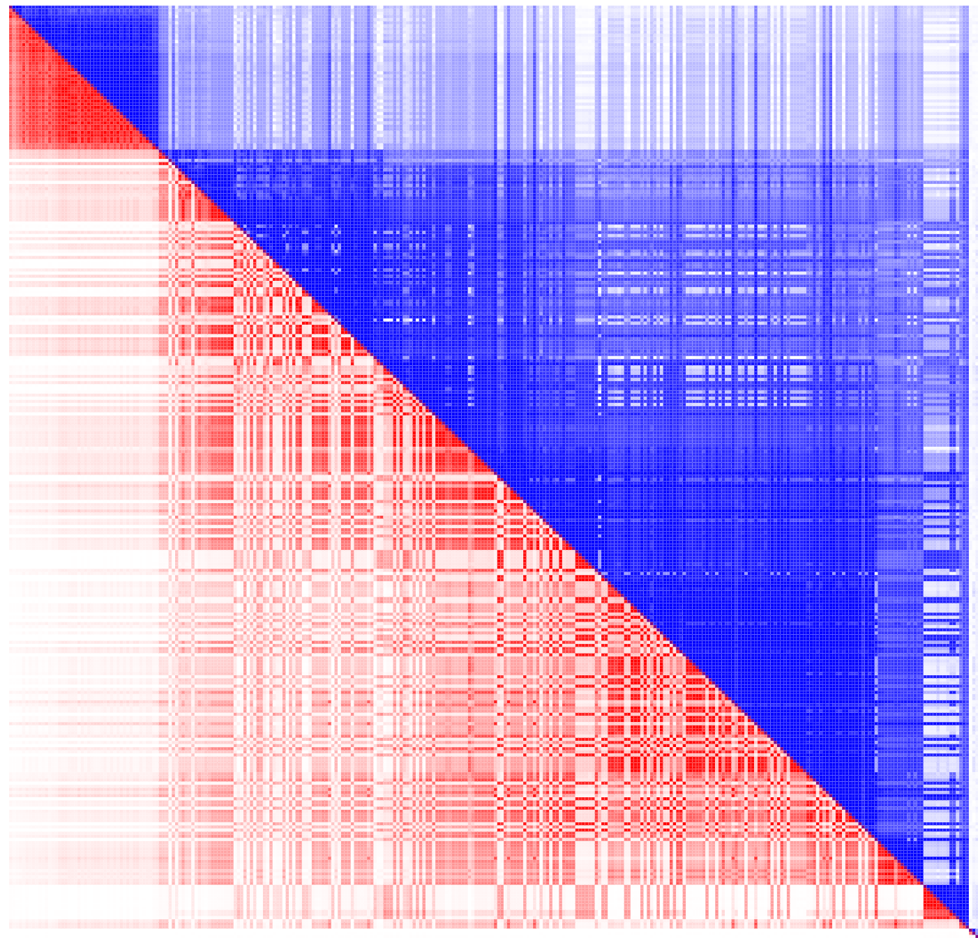
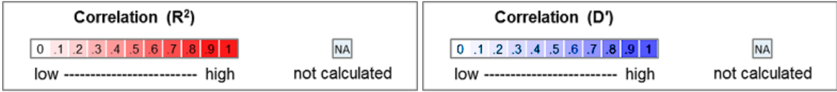
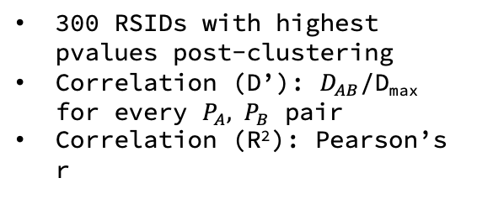
Pre-Clustering
300 RSIDs with highest pvalues post-clustering
Correlation (D’): $D_{AB}$/D_{max} for every $P_{A}{, P}_{B}$ pair
Correlation (R²): Pearson’s r
Notes:
Here was linkage disequilibrium for the 300 RSIDs on chromosome 1 with the highest post-clustering p-values
Extremely high linkage – this is likely due to the set of extremely significant pvalues all close together on chromosome 1

Slide 19
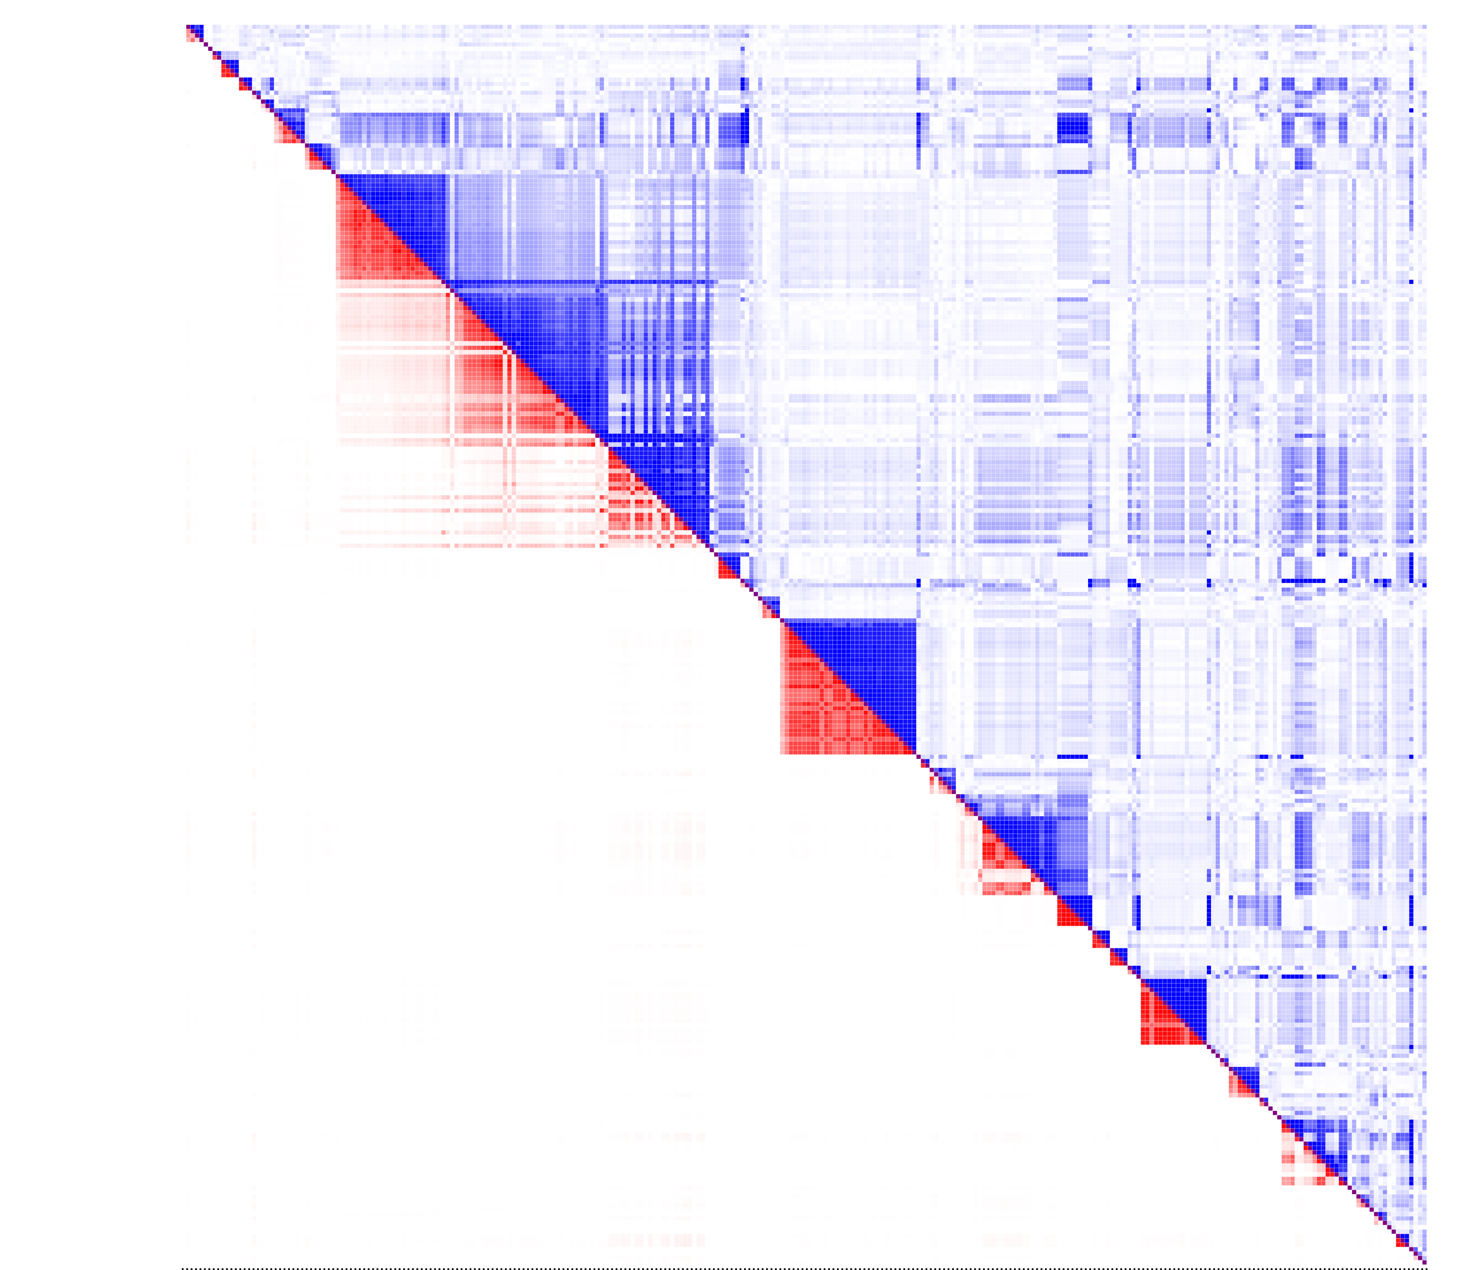
Post-Clustering: bw=40,000
300 RSIDs with highest pvalues post-clustering
Correlation (D’): $D_{AB}$/D_{max} for every $P_{A}{, P}_{B}$ pair
Correlation (R²): Pearson’s r
Notes:
A bandwidth of 40,000 removed most of the linkage disequilibrium, but some still remains

Slide 20
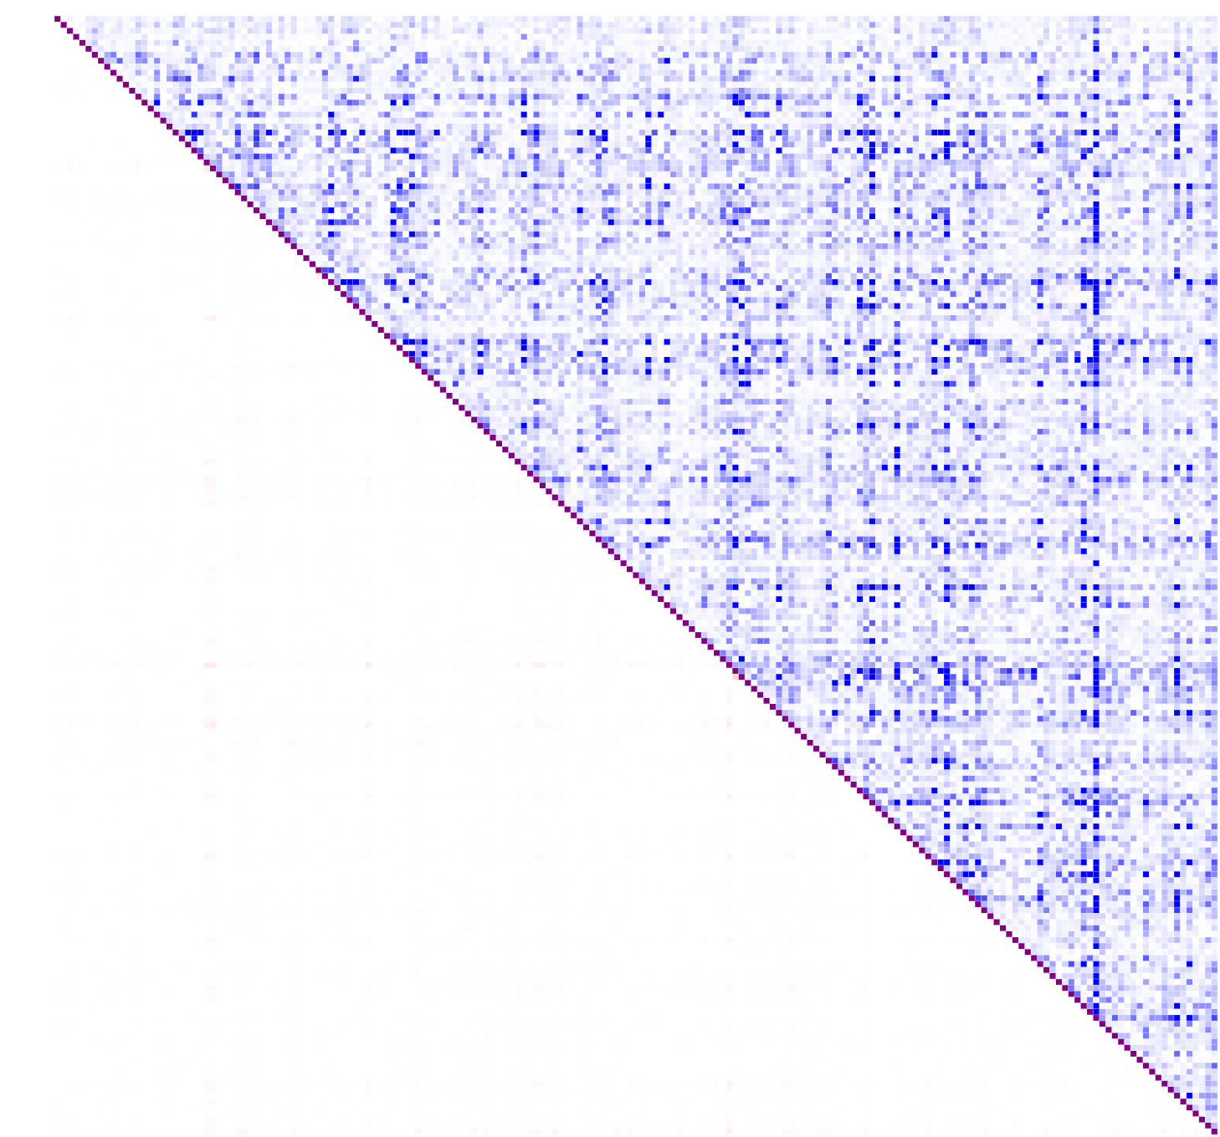
Post-Clustering: bw=400,000
300 RSIDs with highest pvalues post-clustering
Correlation (D’): $D_{AB}$/D_{max} for every $P_{A}{, P}_{B}$ pair
Correlation (R²): Pearson’s r
Notes:
The block structure disappears with a bandwidth of 400,000

Slide 21
Polygenic Risk Scores (future work)
Notes:
Lastly, I have multiple family members with ADHD, so I wanted to generate some prediction score using this data,
And then see if the members of my family with ADHD had a higher score than the members without.

Slide 22
Linkage disequilibrium prediction⁹
LDPred: infer posterior mean effect size of markers using effect size prior and reference LD information
Risk score using GWAS summary statistics (LD Score Regression)
Other metrics?
Notes:
The most commonly cited polygenic risk score estimator is LDPred, which uses a technique called LD Score Regression (This was popularized in the last few years)
But I still have to figure out the best way to generate some model that’s able to predict given new 23andme data

Slide 23
References
Faraone, S., Asherson, P., Banaschewski, T. et al. Attention-deficit/hyperactivity disorder. Nat Rev Dis Primers 1, 15020 (2015). https://doi.org/10.1038/nrdp.2015.20
Demontis, D., Walters, R. K., Martin, J., Mattheisen, M., Als, T. D., Agerbo, E., ... & Cerrato, F. (2019). Discovery of the first genome-wide significant risk loci for attention deficit/hyperactivity disorder. Nature genetics, 51(1), 63-75.
Heal, D. J., Smith, S. L., Gosden, J., & Nutt, D. J. (2013). Amphetamine, past and present–a pharmacological and clinical perspective. Journal of Psychopharmacology, 27(6), 479-496.
Franke, B., Faraone, S. V., Asherson, P., Buitelaar, J., Bau, C. H. D., Ramos-Quiroga, J. A., ... & Lesch, K. P. (2012). The genetics of attention deficit/hyperactivity disorder in adults, a review. Molecular psychiatry, 17(10), 960-987.
Alberts-Corush J, Firestone P, Goodman JT. Attention and impulsivity characteristics of the biological and adoptive parents of hyperactive and normal control children. Am J Orthopsychiatry 1986; 56: 413–423.
Sprich S, Biederman J, Crawford MH, Mundy E, Faraone SV. Adoptive and biological families of children and adolescents with ADHD. J Am Acad Child Adolesc Psychiatry 2000; 39: 1432–1437.
Burt SA. Rethinking environmental contributions to child and adolescent psychopathology: a meta-analysis of shared environmental influences. Psychol Bull 2009; 135: 608–637.
Bulik-Sullivan, B. K., Loh, P. R., Finucane, H. K., Ripke, S., Yang, J., Patterson, N., ... & Schizophrenia Working Group of the Psychiatric Genomics Consortium. (2015). LD Score regression distinguishes confounding from polygenicity in genome-wide association studies. Nature genetics, 47(3), 291.

Slide 24
References
Vilhjálmsson, B. J.; et al. (2015). "Modeling linkage disequilibrium increases accuracy of polygenic risk scores". American Journal of Human Genetics.
Comaniciu, D., & Meer, P. (2002). Mean shift: A robust approach toward feature space analysis. IEEE Transactions on pattern analysis and machine intelligence, 24(5), 603-619.

Slide 25
Questions?

